Slide 1
Dopant diffusion

Slide 2
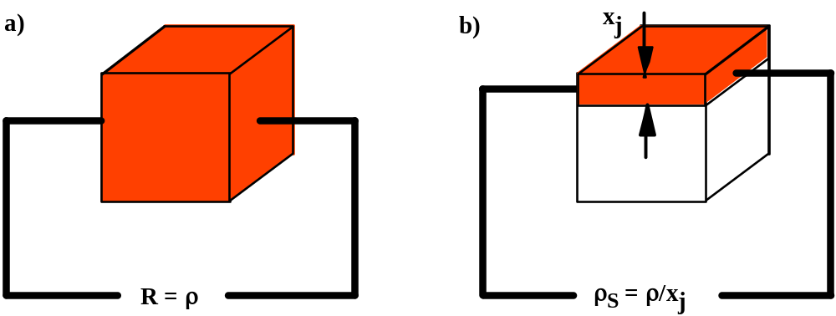
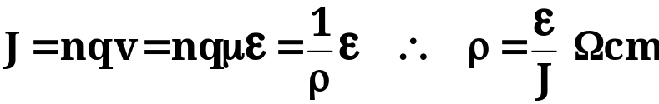
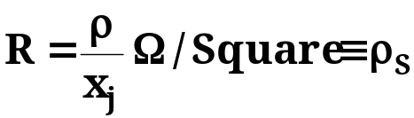
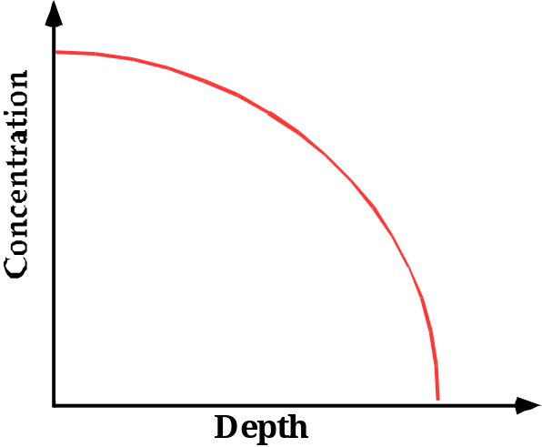
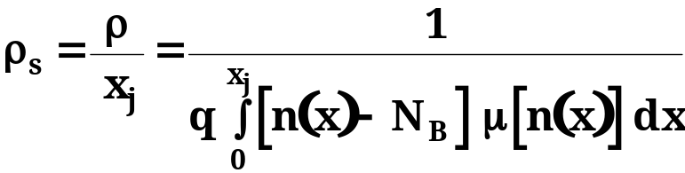
Resistivity and surface concentration
The resistivity is given by
The sheet resistance of a shallow junction is
For a non-uniformly doped layer,
This eq. has been numerically integrated by Irvin for simple analytical profiles
Sheet resistance can be experimentally measured by a four point probe technique.
Doping profiles can be measured by SIMS (chemical) or spreading R (electrical).

Slide 3
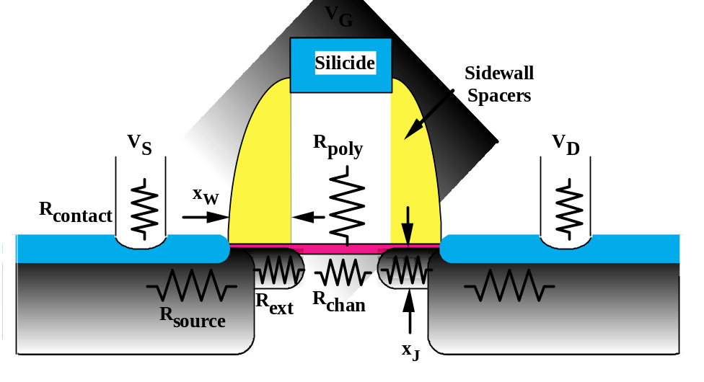
Technology scaling and junction depth
Doping profiles determine many short-channel characteristics in MOS devices.
Resistance impacts drive current.
Scaling implies all lateral and vertical dimensions scale by the same factor.
Generally doping levels need to increase and x_{J} values need to decrease.

Slide 4
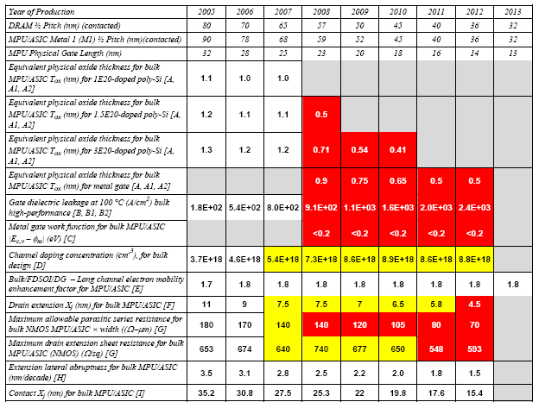
ITRS predictions for junctions depth

Slide 5
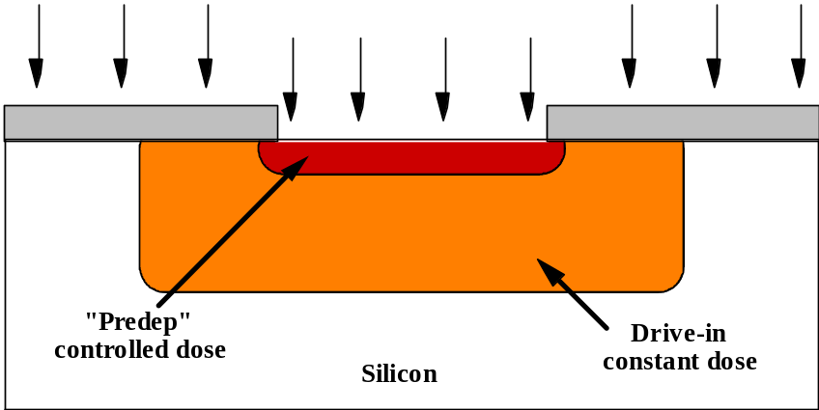
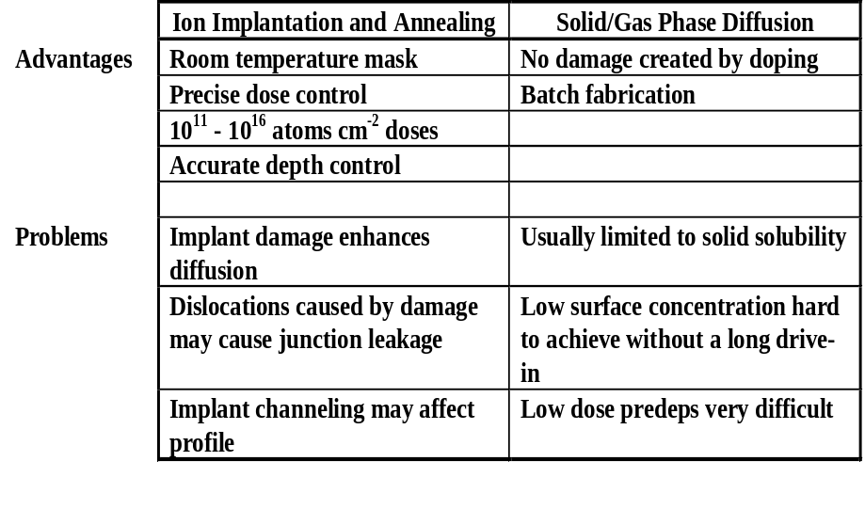
Diffusion
Diffusion is the redistribution of atoms from regions of high concentration of mobile species to regions of low concentration. It occurs at all temperatures, but the diffusivity has an exponential dependence on T.
Pre-deposition: doping often proceeds by an initial pre-dep step to introduce the required dose of dopant into the substrate.
Drive-In: a subsequent drive-in anneal then redistributes the dopant giving the required xJ and surface concentration.

Slide 6
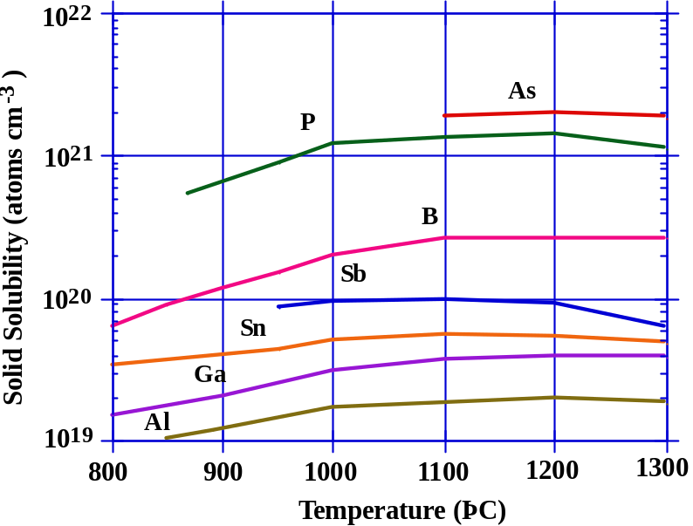
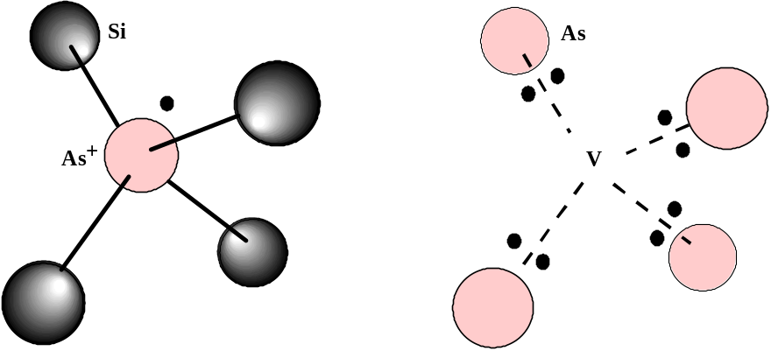
Solid solubility
Dopants are soluble in bulk silicon up to a maximum value before they precipitate into another phase.
Dopants may have an “electrical” solubility that is different than the solid solubility defined above.
One example - As4V -electrically inactive complex.

Slide 7
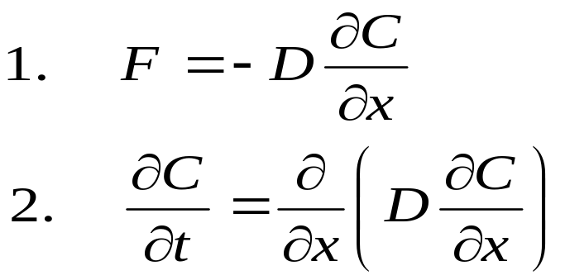
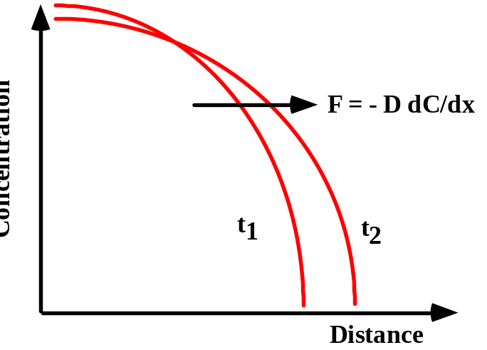
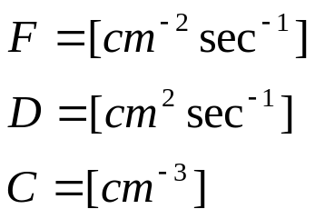
Fick’s laws
Where F is dopant flux
C is dopant concentration
D is diffusivity
F_{in}
F_{out}
Δx
Notes:
Derivare la formula 2. con i flussi nel cubo
“what goes in and does not go out stays there “

Slide 8
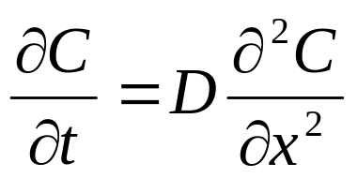
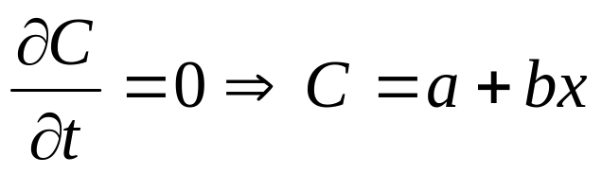
Analytic solutions of diffusion equation
Steady state
Assuming D is a constant (e.g. at fixed T) we can write
Steady state solution:
Notes:
Richiamare ossidazione del silicio ( flusso ossidanti attraverso l’ossido)

Slide 9
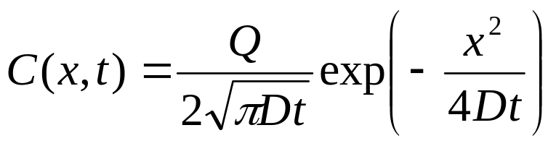
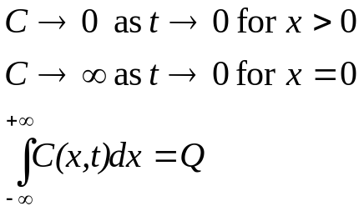
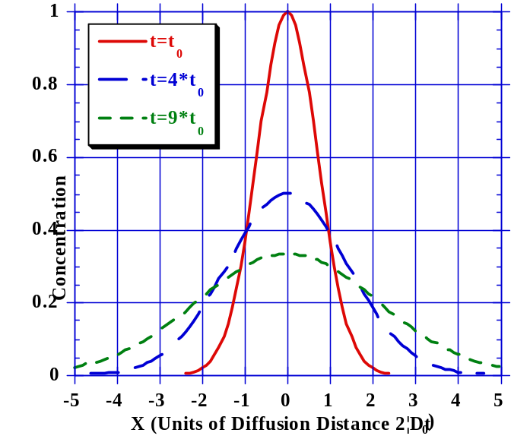
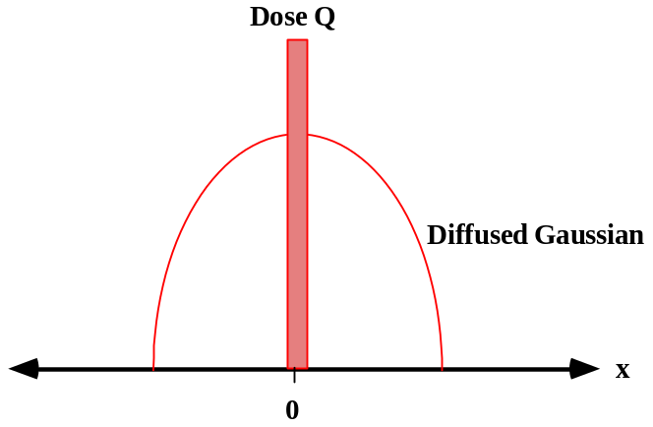
Analytic solutions of diffusion equation
Gaussian solution
A delta function of dopant in the middle of a lightly doped region
Boundary conditions

Slide 10
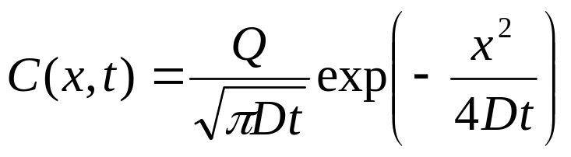
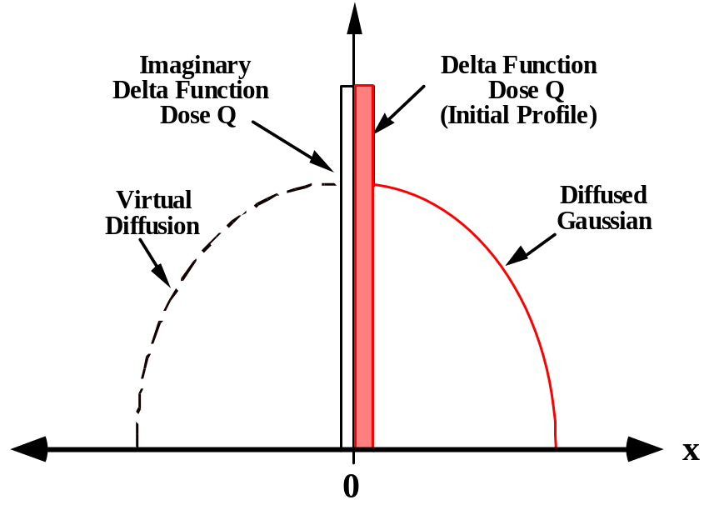
Analytic solutions of diffusion equation
Gaussian solution near a surface
A surface a x=0 is treated as a mirroring boundary condition (see picture)

Slide 11
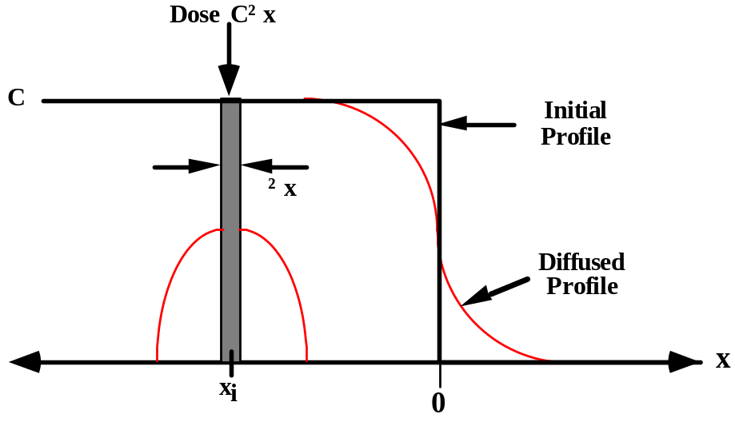
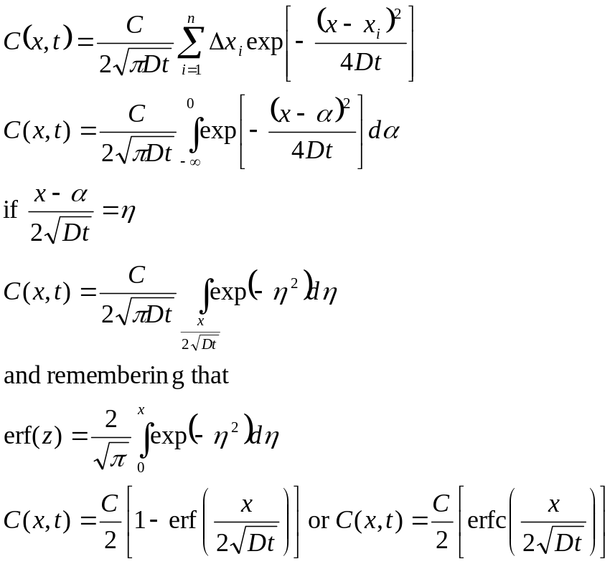
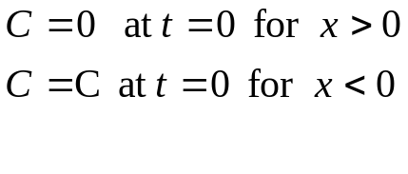
Analytic solutions of diffusion equation erfc solution
Diffusion from a infinite source of dopant
Can be thought as a “sum” of Gaussian problems
Boundary conditions

Slide 12
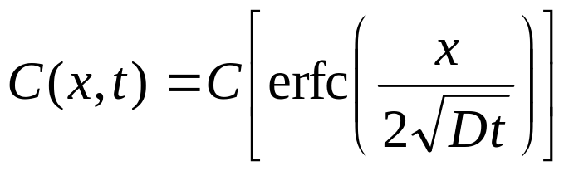
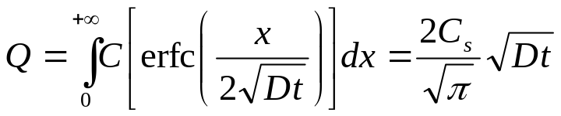
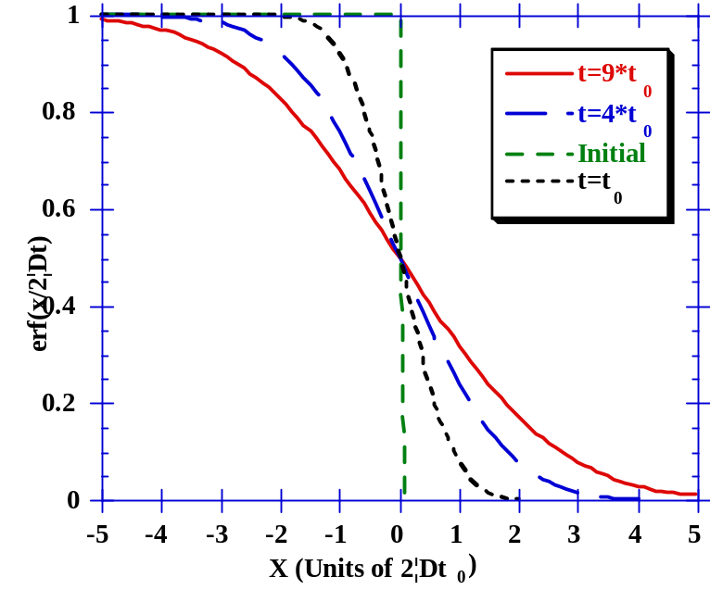
Analytic solutions of diffusion equation erfc solution near a surface
Symmetry considerations lead to:
Dose calculation:
Important consequences of error function solution:
  Symmetry about mid-point allows solution for constant surface concentration to be derived.
  Dose beyond x = 0 continues to increase with annealing time.

Slide 13
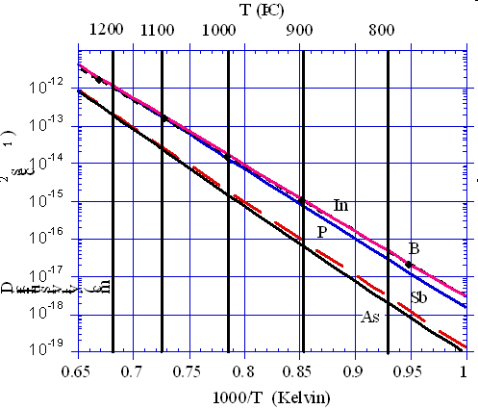
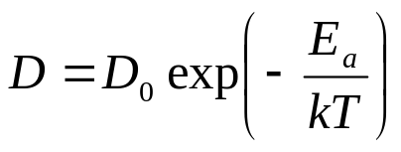
Intrinsic Diffusion coefficients
For intrinsic doping condition, diffusion coefficients follow an Arrhenius law
Element | D⁰ (cm2sec-1) | E_{a}(eV)
Si | 560 | 4.76
B | 1 | 3.5
In | 1.2 | 3.5
As | 9.17 | 3.99
Sb | 4.58 | 3.88
P | 4.70 | 3.68
Notes:
Sottolineare che valgono nel caso intrinseco ( Na<<Ni), ma che ad alte temperature ni e’ elevato.
A 1000 C ni=7.14E18 cm-3

Slide 14

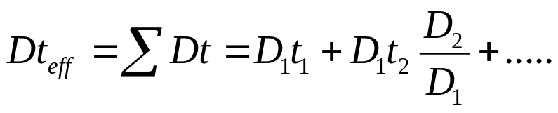
Effect of multiple diffusion steps
If a dopant is diffused at temperature T₁ for time t₁ and then is diffused at temperature T₂ for time t₂, the total effective Dt is given by the sum of all the individual Dt products.
Can also be written as
Since D depends exponentially on T, only the higher temperature diffusion steps are important to determine the effective diffusion profile
Notes:
Far notare che il rempo necessario a tem[peratura T2 per diffondere un profilo quanto lo si farebbe diffondere per un tempo t1 a temperatura T1 e’ ; t2=t1 x D1/D2

Slide 15
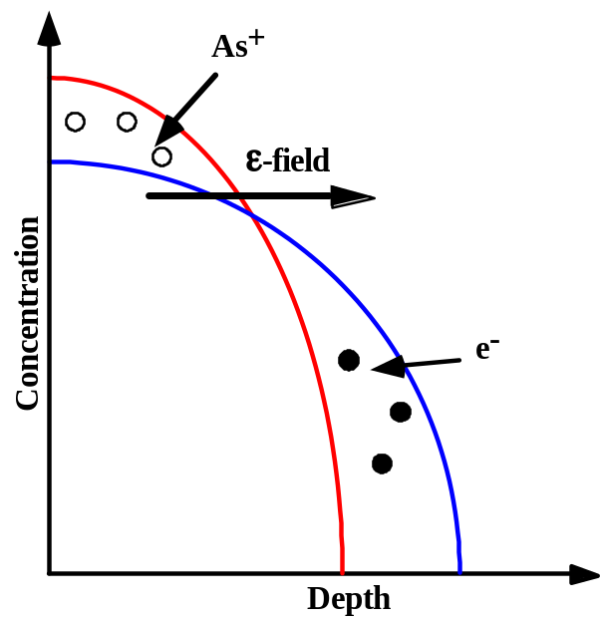
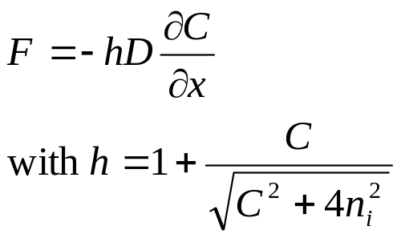
Correction to Fick’s law
Electric field correction:
  Higher mobility of electrons and holes compared to ions
  Electrons and holes tend to diffuse forward, leaving behind charged donors or acceptors
  An electric field is set up ( in steady state condition electrons/holes drift flow will balance diffusion flow)
  The electric field drag donor/acceptor atoms too → enhanced diffusivity
Fick’s first law can be re-written as:
Notes:
Sottolineare che al max h=2, ma che l’impatto del campo elettrico puo’ essere maggiore.
Es: impianto As in presenza di piccola concentrazionei di B. L’As genera il campo elettrico, che sposta il B.

Slide 16
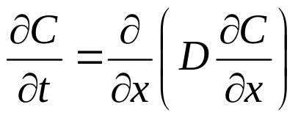
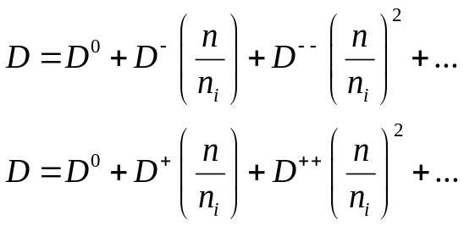
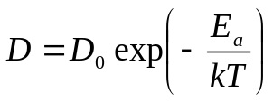
Correction to Fick’s law
Concentration dependent diffusion:
  In extrinsic conditions, profiles don’t match gaussian or erf functions profiles → box shaped profiles for high concentration regions suggest that diffusion is faster where concentration is higher.
  D depends on C !
  Second Fick’s law still holds, but in the form
Experimentally its is found that:
n type
Element | D₀⁰ | E_{a} | D₀⁺ | E_{a}+ | D₀⁻ | E_{a}- | D₀⁻ ⁻ | E_{a} ⁻ ⁻
Si | 560 | 4.76
B | 0.05 | 3.5 | 0.95 | 3.5
In | 0.6 | 3.5 | 0.6 | 3.5
As | 0.01 | 3.44 |  |  | 31.0 | 4.15
Sb | 0.21 | 3.65 |  |  | 15.0 | 4.08
P | 3.85 | 3.66 |  |  | 4.44 | 4.0 | 44.2 | 4.37
p type
And every “D” can be written in the form
D in cm²sec⁻¹
E_{a} in eV
Notes:
Spiegare che la forma di D puo’ essere spiegata per interazione con difetti di punto carichi. Si tratta in di una somma pesata sulla probabilita’ dello stato carico del difetto.

Slide 17
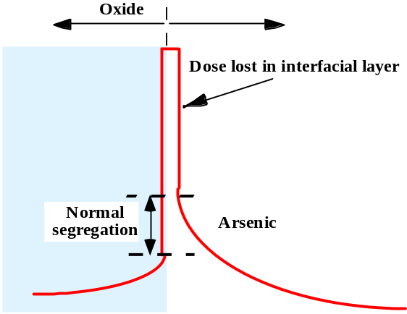
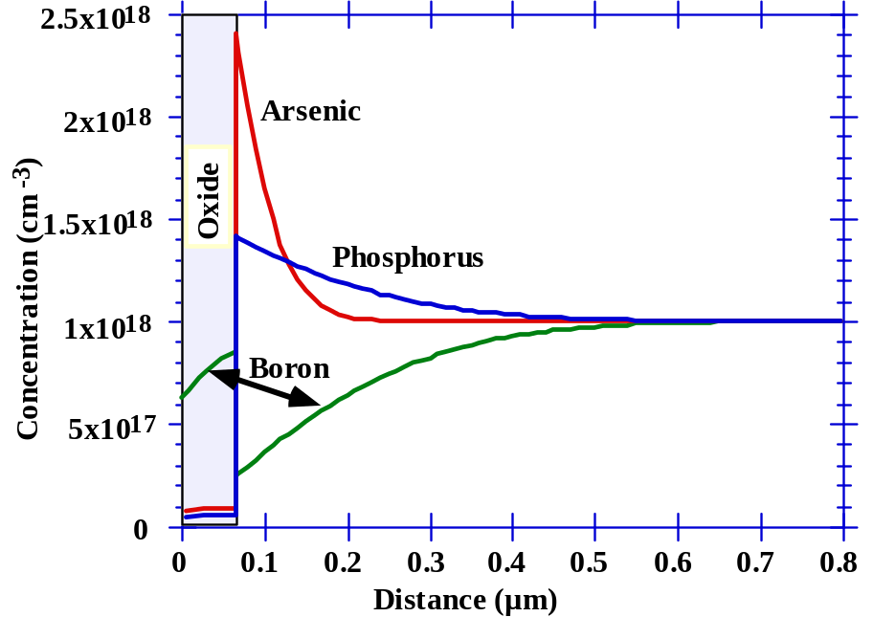
Other factors influencing diffusion
Segregation
  Different solid solubility in different materials
Interfacial dopant pile-up
  Dopants piling up in a very thin, inactive interfacial layer between Si and SiO₂
N-type dopants tend to pile-up
Boron depletes

Slide 18
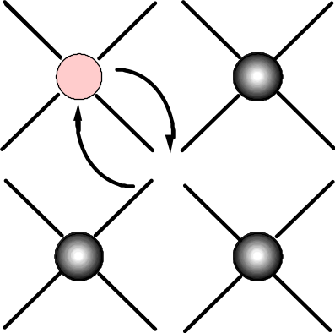
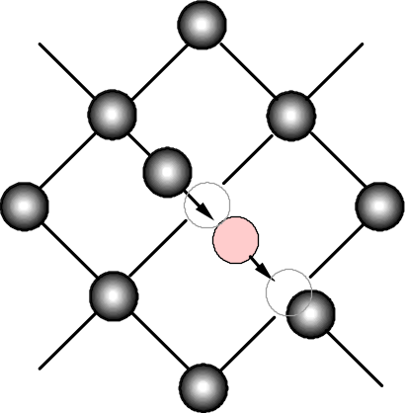
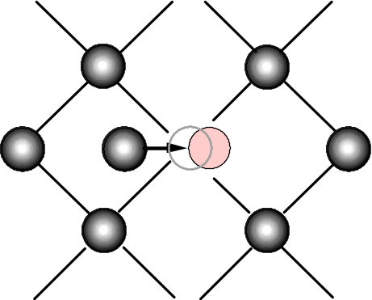
Diffusion at atomic scale
Diffusion of dopants is strictly related to the presence of point defects
A vacancy can let an atom hop to an adjacent site
An interstitial can kick out an atom from a lattice position
An interstitial/dopant pair can travel along bonds directions
Interstitial-assisted diffusion

Slide 19
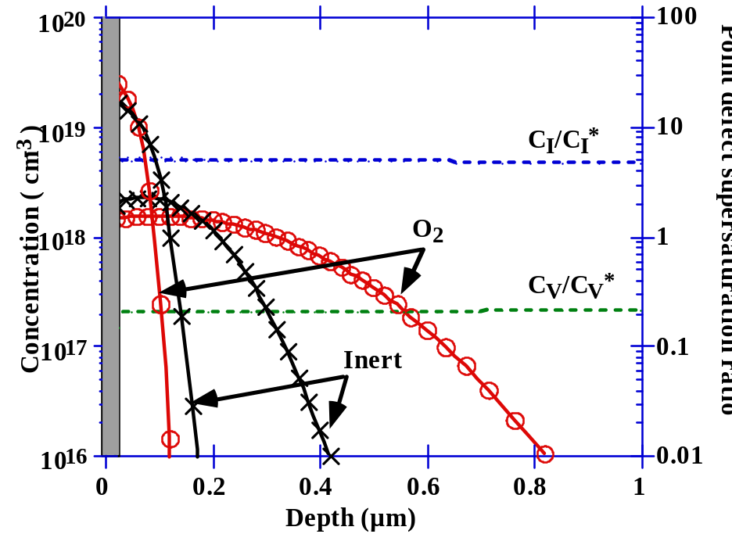
Diffusion at atomic scale
Oxidation can enhance or retard diffusion
Oxidation injects interstitials and absorbs vacancies:
  B e P show interstitial-assisted diffusion
  Sb shows vacancy-assisted diffusion
Notes:
Accennare al fatto che Sb e’ un atomo grosso, ed e’ meno facile che sia scalzato da un interstiziale…

Slide 20
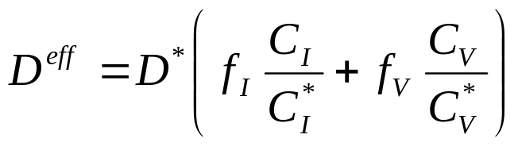
Diffusion at atomic scale
The diffusivity can be generally written as:
f_{i}= interstitial type mechanism fraction
f_{v}= vacancy type mechanism fraction
C_{I/V}= interstitial/vacancy concentration
C*_{I/V}= interstitial/vacancy equilibrium concentration
D*= equilibrium diffusivity in inert conditions
Element | f_{i} | f_{v}
Si | 0.6 | 0.4
B | 1 | 0
P | 1 | 0
As | 0.4 | 0.6
Sb | 0.02 | 0.98
Notes:
Accennare al fatto che Sb e’ un atomo grosso, ed e’ meno facile che sia scalzato da un interstiziale…e viceversa per B e P.
Accennare anche a calcoli che permettono di mettere in relazione parametri marcoscopici a prametri microscopici ( vedere Plummer pgg. 426-436). Riportare i conti qui sotto ?

Slide 21

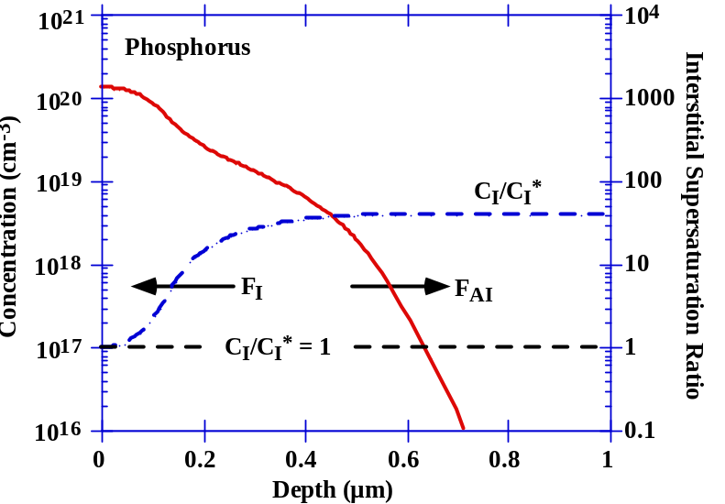
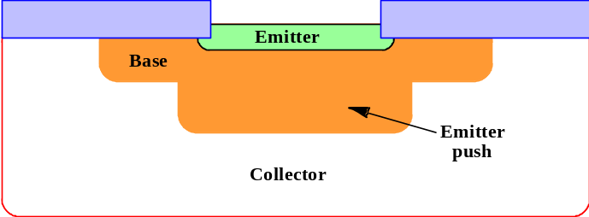
Modeling of atomic scale diffusion
Take as an example interstitial assisted diffusion; we can consider a dopant A interacting with an interstitial as:c
AI is the interstitial assisted mobile species
I-assisted diffusion can generate a chemical pumping of I defects into the substrate, thus explaining phenomena as the enhanced tail diffusion for P and the “emitter push”
Notes:
Riflettere sulla formulina:
Un aumento degli interstiziali produce piu’ specie mobili → aumenta la diffusione
Es. Una specie diffonde assistita da I, poi rilascia intrestiziali nel bulk, dove la concentrazione di I va quindi aumentando → la diffusione aumenta verso il bilk → questo spiega l’aumentata diffusione delle code come nel caso del P.
Anche il fenomeno di emitter “push” e’ spiegato dall’iniezione di interstiziali (P nell’emitter inietta I che fanno diffondere il B della base)

Slide 22
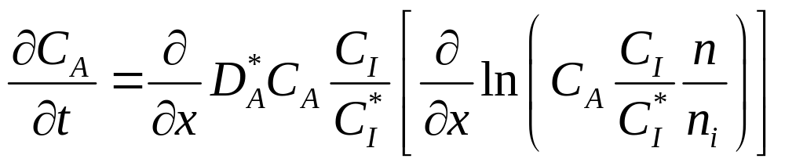
Modeling of atomic scale diffusion
If we consider the interstitial assisted reaction:
to be in chemical equilibrium (C_{AI}=kC_{A}C_{I}), we can derive a powerful expression that relates the microscopic diffusion to macroscopic and measurable parameters
Notes:
Derivare la formulno finale → vedi appunti cartacei

Slide 23
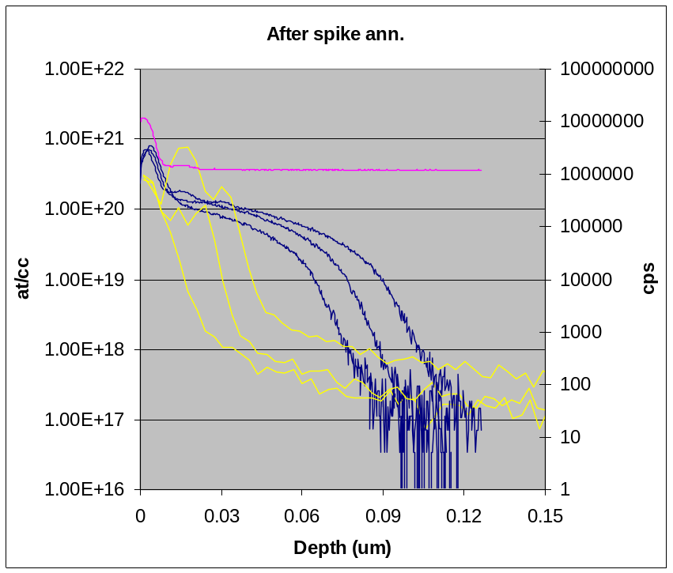
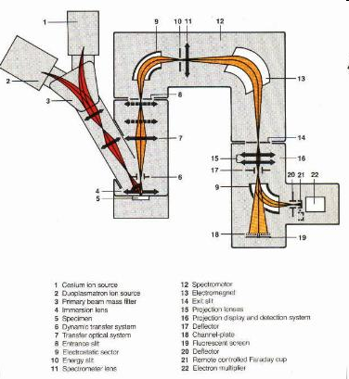
Measurements methods
SIMS
The sample is bombarded with ions (O⁺ or Cs⁺)
Impinging ions sputter sample atoms
Atoms are mass-analyzed
F
B
Si
Notes:
Citare 4 point probe e CV profiling

Slide 24
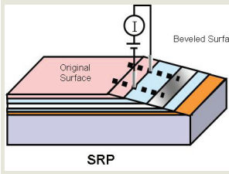
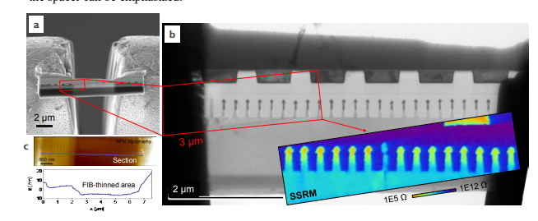

SRP and SRRM
Spreading Resistance Profiling (SRP)
Scanning Spreading Resistance Microscopy (SSRM)
U. Celano et al. “Individual Device Analysis Using Hybrid TEM-Scalpel SSRM Metrology” Frontiers of Characterization and Metrology for Nanoelectronics (FCMN) conference 2017
Scanning-Spreading-Resistance-Microscopy-(SSRM).pdf (parksystems.cn)

Slide 25


Electron holography
Hannes Lichte and Michael Lehmann 2008 Rep. Prog. Phys. 71 016102

Slide 26
Bibliography and links for this lesson
Erf and Erfc information and details:
  http://mathworld.wolfram.com/Erf.html
Irvin curves:
  http://fabweb.ece.uiuc.edu/gt/irvin/

